Slide 1
Image Processing I
…with most slides shamelessly stolen
from Steve Seitz and Gonzalez & Woods

Slide 2
Today
Image Formation
Range Transformations
  Point Processing
Programming Assignment #1 OUT
Reading for this week:
  Gonzalez & Woods, Ch. 3
  Forsyth & Ponce, Ch. 7

Slide 3

Image Formation
f(x,y) = reflectance(x,y) * illumination(x,y)
Reflectance in [0,1], illumination in [0,inf]

Slide 4

Sampling and Quantization

Slide 5

Sampling and Quantization

Slide 6
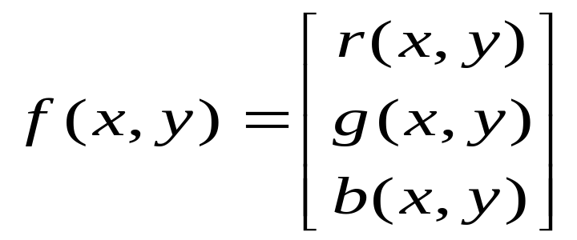
What is an image?
We can think of an image as a function, f, from R² to R:
  f( x, y ) gives the intensity at position ( x, y )
  Realistically, we expect the image only to be defined over a rectangle, with a finite range:
    f: [a,b]x[c,d] → [0,1]
A color image is just three functions pasted together. We can write this as a “vector-valued” function:
Notes:
As opposed to [0..255]

Slide 7
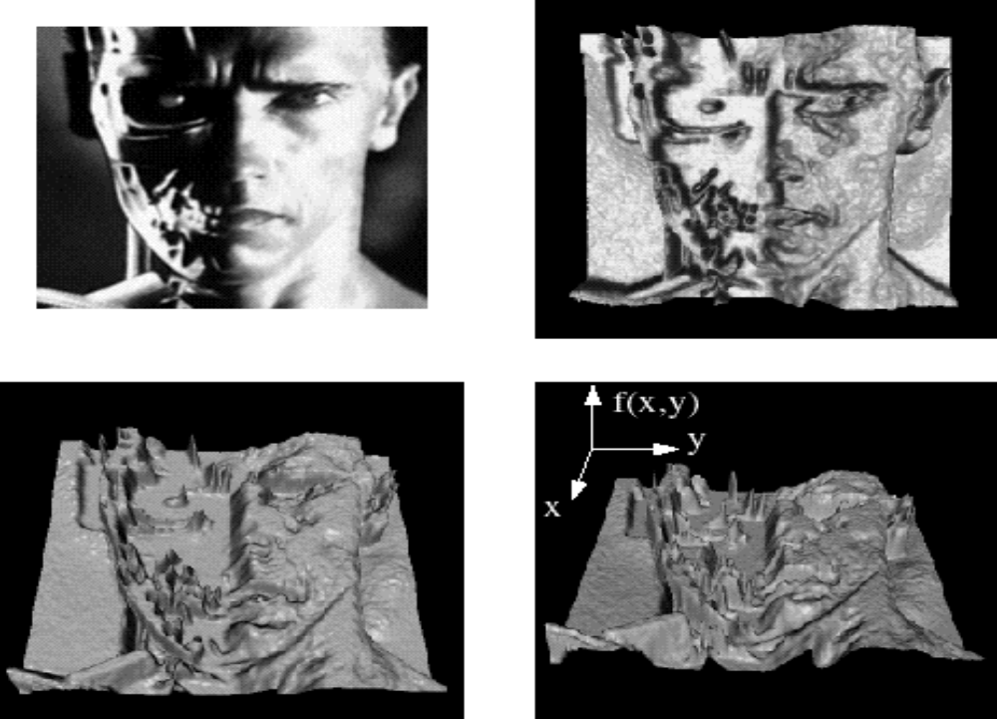
Images as functions
Notes:
Render with scanalyze????

Slide 8

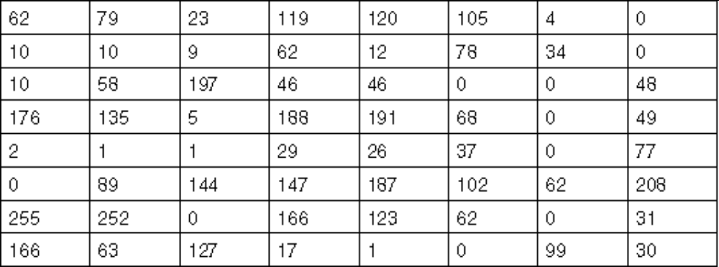
What is a digital image?
We usually operate on digital (discrete) images:
  Sample the 2D space on a regular grid
  Quantize each sample (round to nearest integer)
If our samples are Δ apart, we can write this as:
f[i ,j] = Quantize{ f(i Δ, j Δ) }
The image can now be represented as a matrix of integer values

Slide 9

Image processing
An image processing operation typically defines a new image g in terms of an existing image f.
We can transform either the range of f.
Or the domain of f:
What kinds of operations can each perform?
Notes:
Use photoshop to make something grayscale

Slide 10
Point Processing
The simplest kind of range transformations are these independent of position x,y:
g = t(f)
This is called point processing.
What can they do?
What’s the form of t?
Important: every pixel for himself – spatial information completely lost!

Slide 11
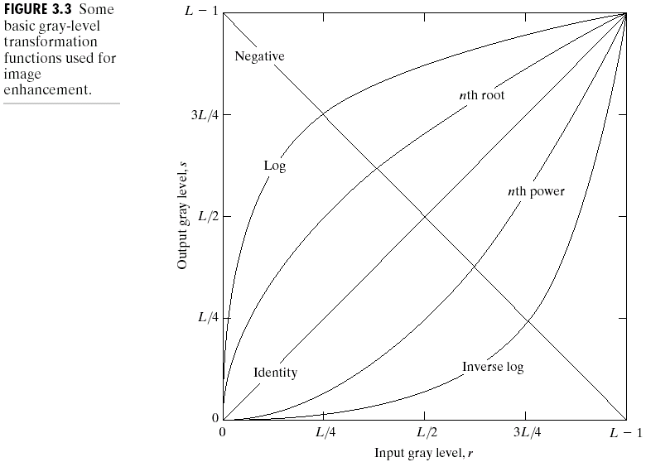
Basic Point Processing

Slide 12
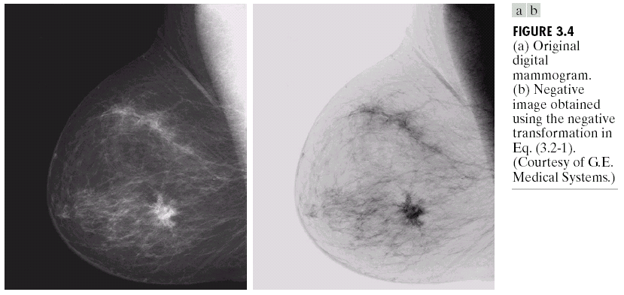
Negative

Slide 13
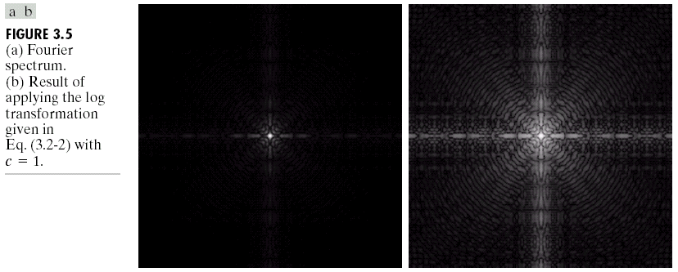
Log

Slide 14
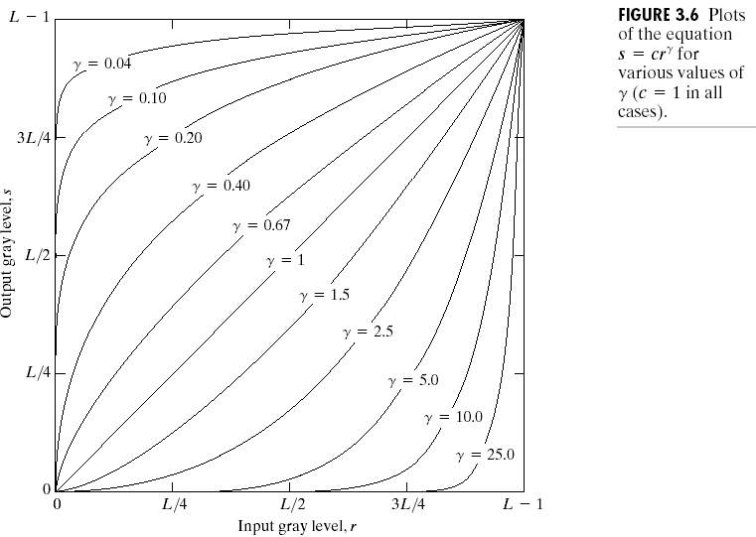
Power-law transformations

Slide 15
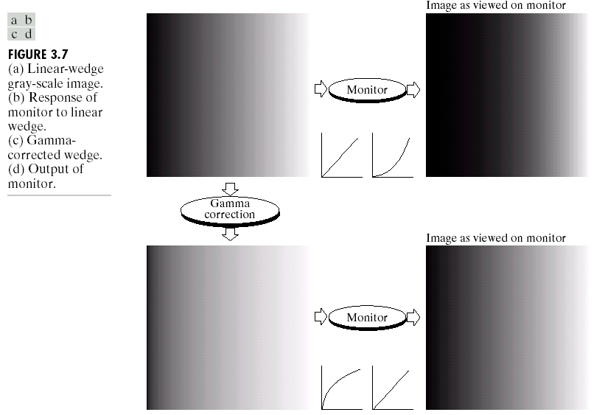
Gamma Correction
Gamma Measuring Applet:
http://www.cs.berkeley.edu/~efros/java/gamma/gamma.html

Slide 16
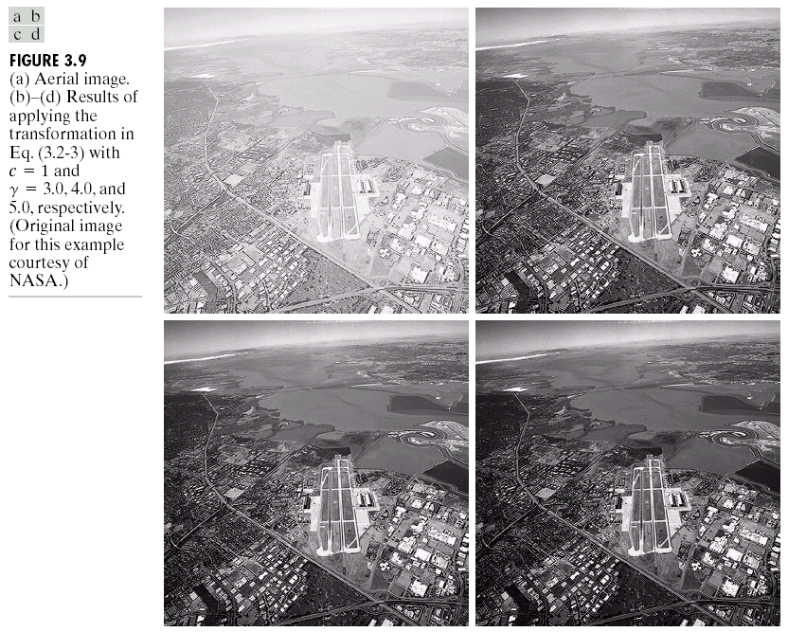
Image Enhancement

Slide 17

Contrast Streching

Slide 18
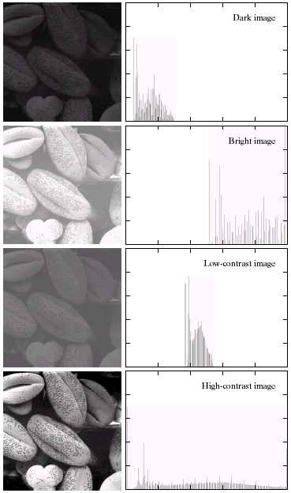

Image Histograms

Slide 19
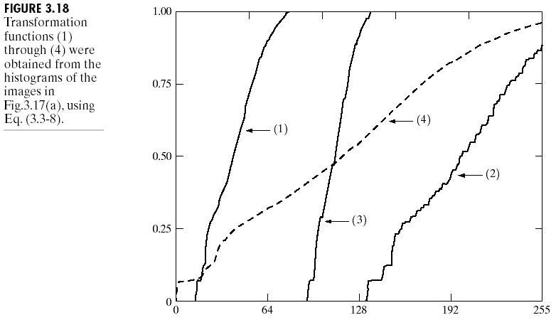
Cumulative Histograms

Slide 20
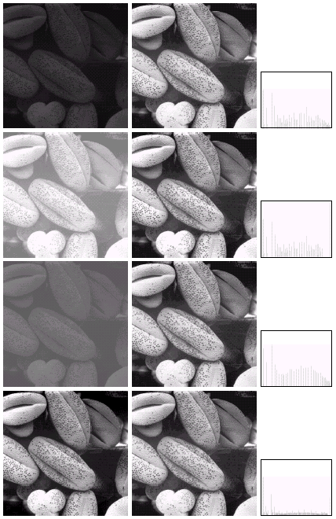

Histogram Equalization

Slide 21
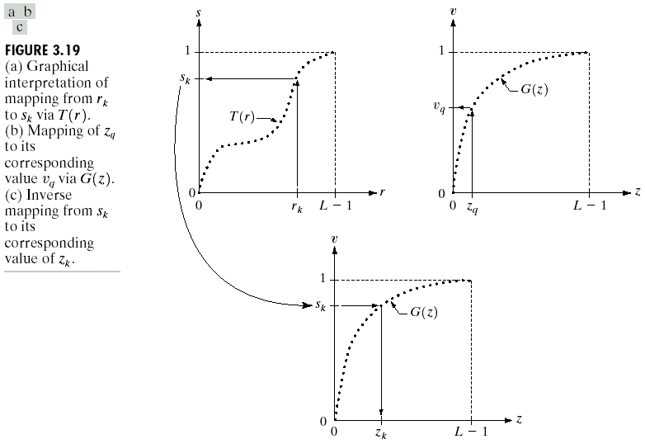
Histogram Matching

Slide 22
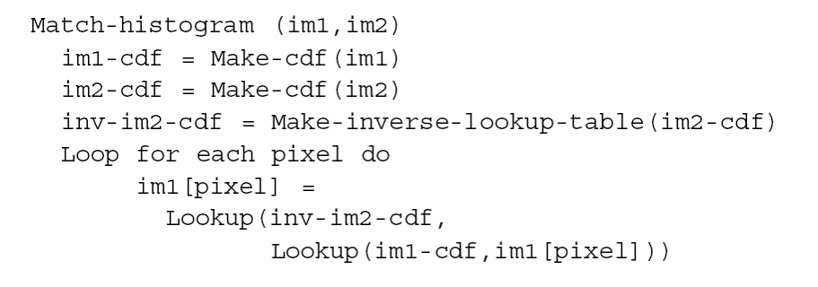
Match-histogram code

Slide 23
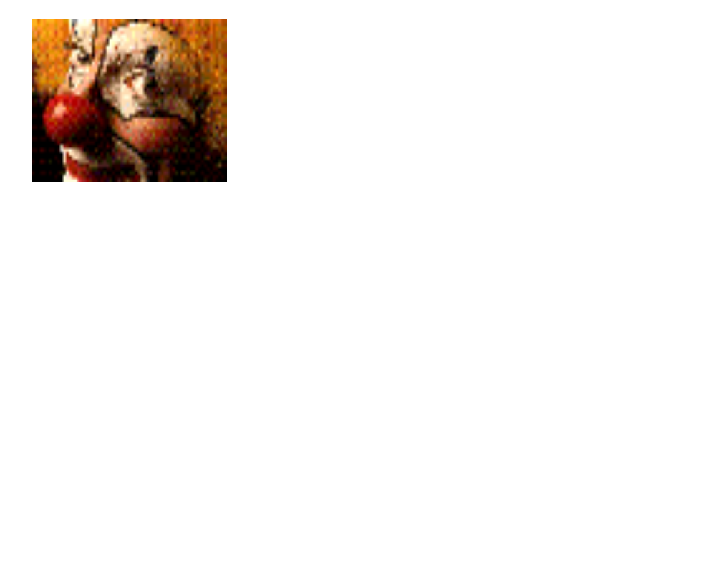
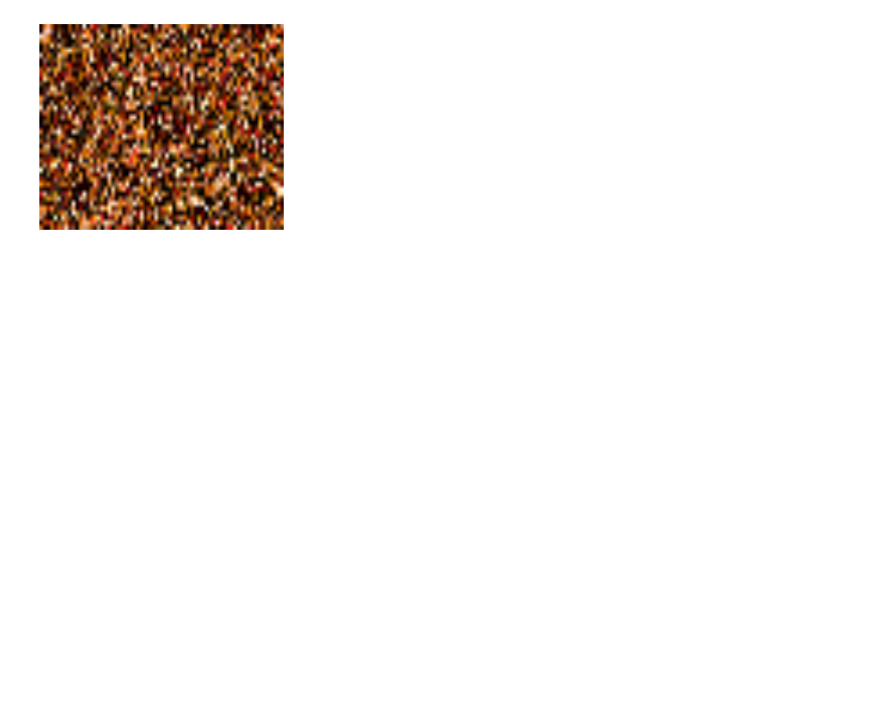
Neighborhood Processing (filtering)
Q: What happens if I reshuffle all pixels within the image?
A: It’s histogram won’t change. No point processing will be affected…
Need spatial information to capture this.

Slide 24
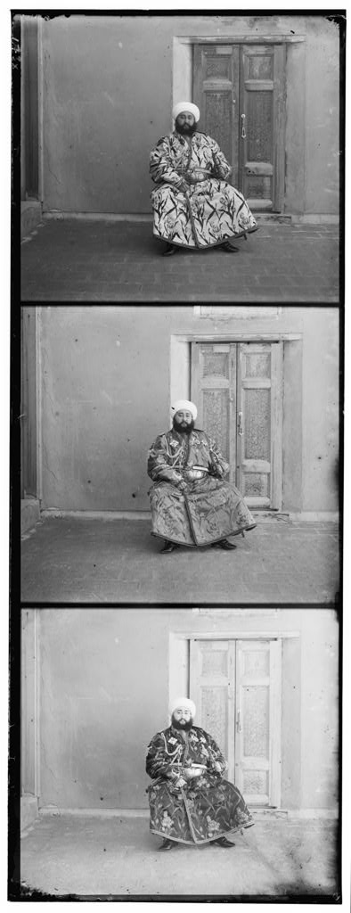
Programming Assignment #1
Easy stuff to get you started with Matlab
  James will hold tutorial this week
Distance Functions
  SSD
  Normalized Correlation
Bells and Whistles
  Point Processing (color?)
  Neighborhood Processing
  Using your data (3 copies!)
  Using your data (other images)

